Slide 1
Evolution & Quality for Infrastructure-as-code: a focused look on TOSCA
D. A. Tamburri, Ph.D.

Slide 2
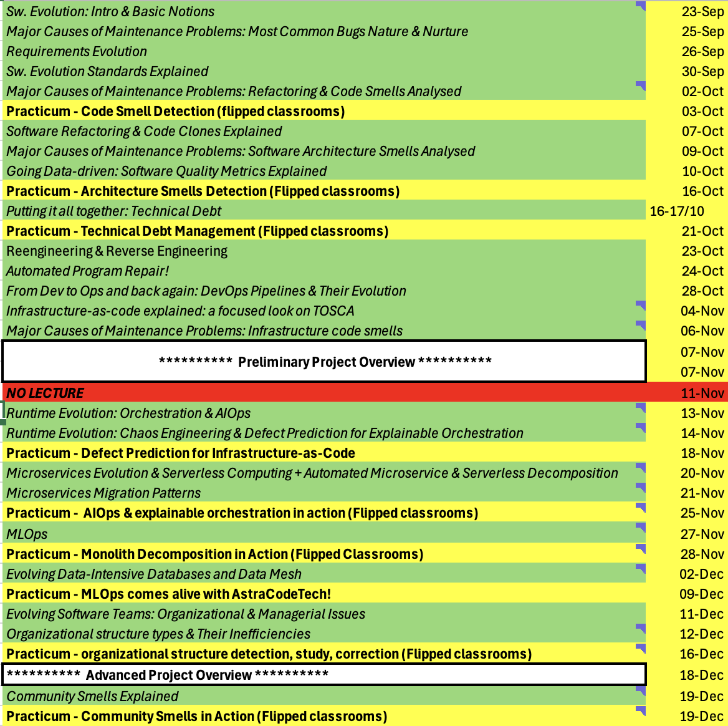

Slide 3
This Friday: Project Presentation Pitches!
Shall we start at 10AM?
You each (per team) have 15 mins + allow 5 mins for questions;
20 mins per team * 7 Teams ➔ 140 + 20 mins for breaks ➔ 160 mins!

Slide 4
DevOps processes and toolchain
- Continuous Architecting
Def. “architect for test, build and deploy, take quality attributes into account, take advantage of feedback from runtime” [1]
- Continuous Integration
Def. “merge all developer
work-copies to a shared mainline frequently” [4]
Examples. Apache Jenkins, Hudson, etc.
- Continuous Testing
Image by Kharnagy (Own work) [CC BY-SA 4.0
(http://creativecommons.org/licenses/by-sa/4.0)],
via Wikimedia Commons
Def. “run tests as part the build pipeline so that every check-in and deployment is validated” [3]
Examples. Selenium+GitHub+LI-API, etc.

Slide 5
DevOps process and toolchain
1.Configuration Management
2. Server Provisioning
5. Self-Adaptation
3. Application Deployment
4. Monitoring

Slide 6
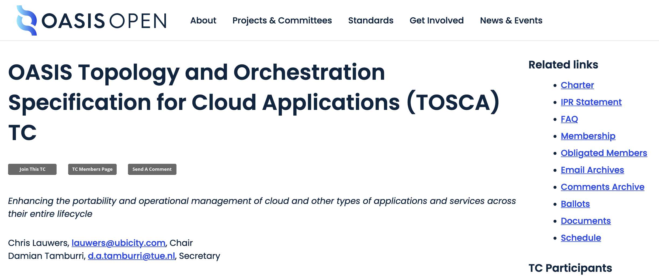

Slide 8
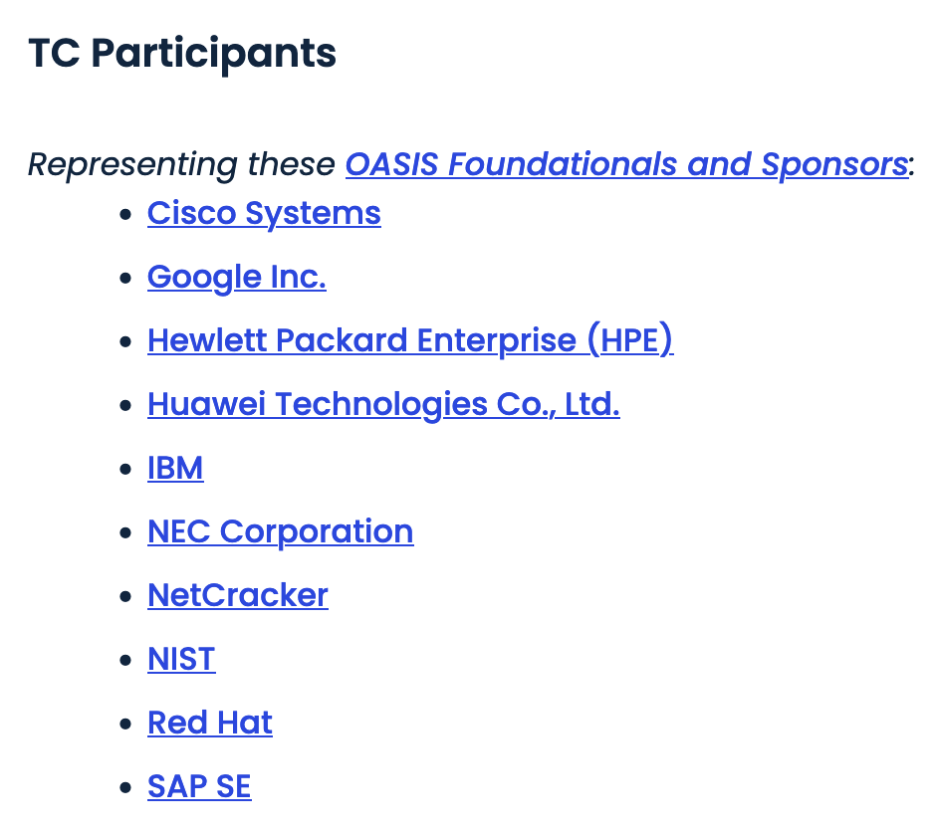

Slide 9
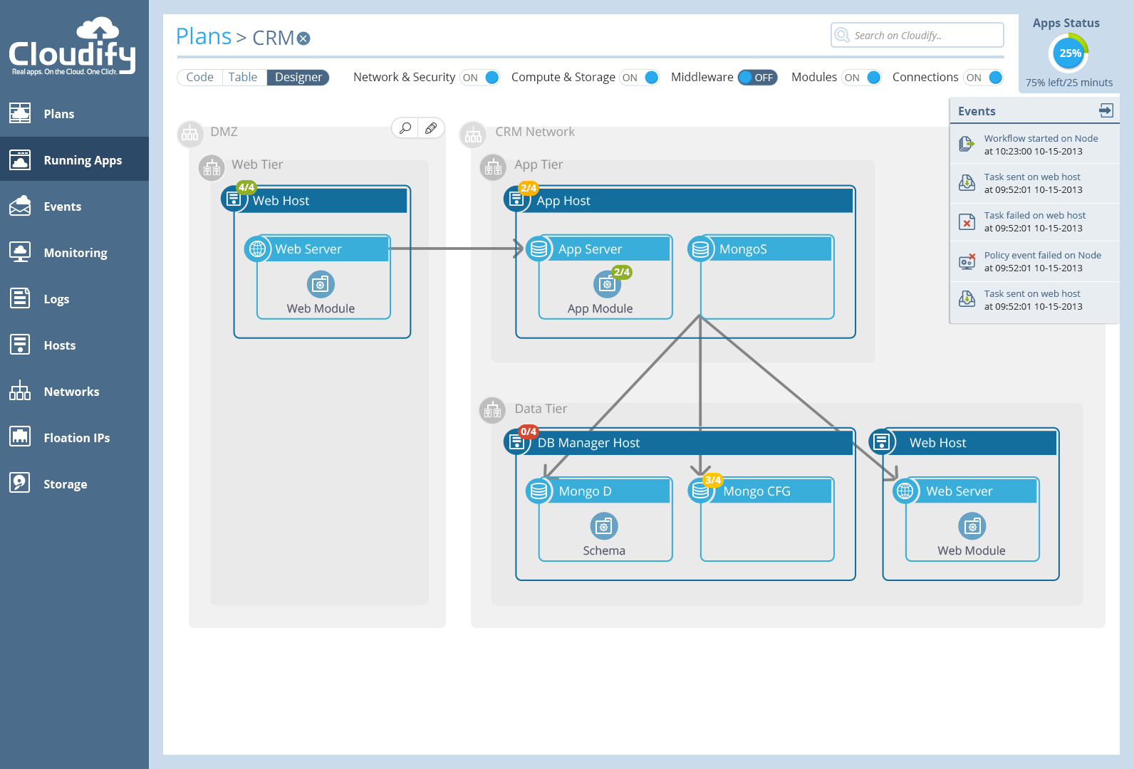
What do we see here?
Host
App module
Middleware
connection
Notes:
http://getcloudify.org/
Cloudify is a Cloud Application Orchestrator. It automates any process you need to perform with regard to your applications over any cloud. Cloudify provides:
Infrastructure Setup
Application Installation
Application Upgrades
Infrastructure Upgrades
Continuous Deployments
Auto-healing
Auto-scaling
Cloudify can work on any environment: IaaS, virtualized or even non-virtualized.
Cloudify executes automation processes using any tool you choose. From shell to Chef, Puppet, etc.
Cloudify monitors your application with any monitoring tool you choose; installing it for you if you like and interfacing with your monitoring tools to get events and metrics into Cloudify’s Policy Engine.

Slide 10
Our focus
Infrastructure
Host
Host
Network
Middleware
Apache
Tomcat
MySQL
Application
Mod_proxy
WAR
Schema

Slide 11
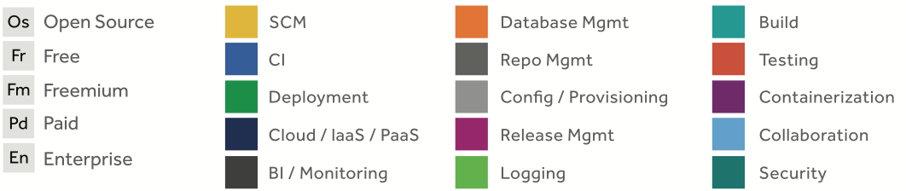
A large number of tools

Slide 12
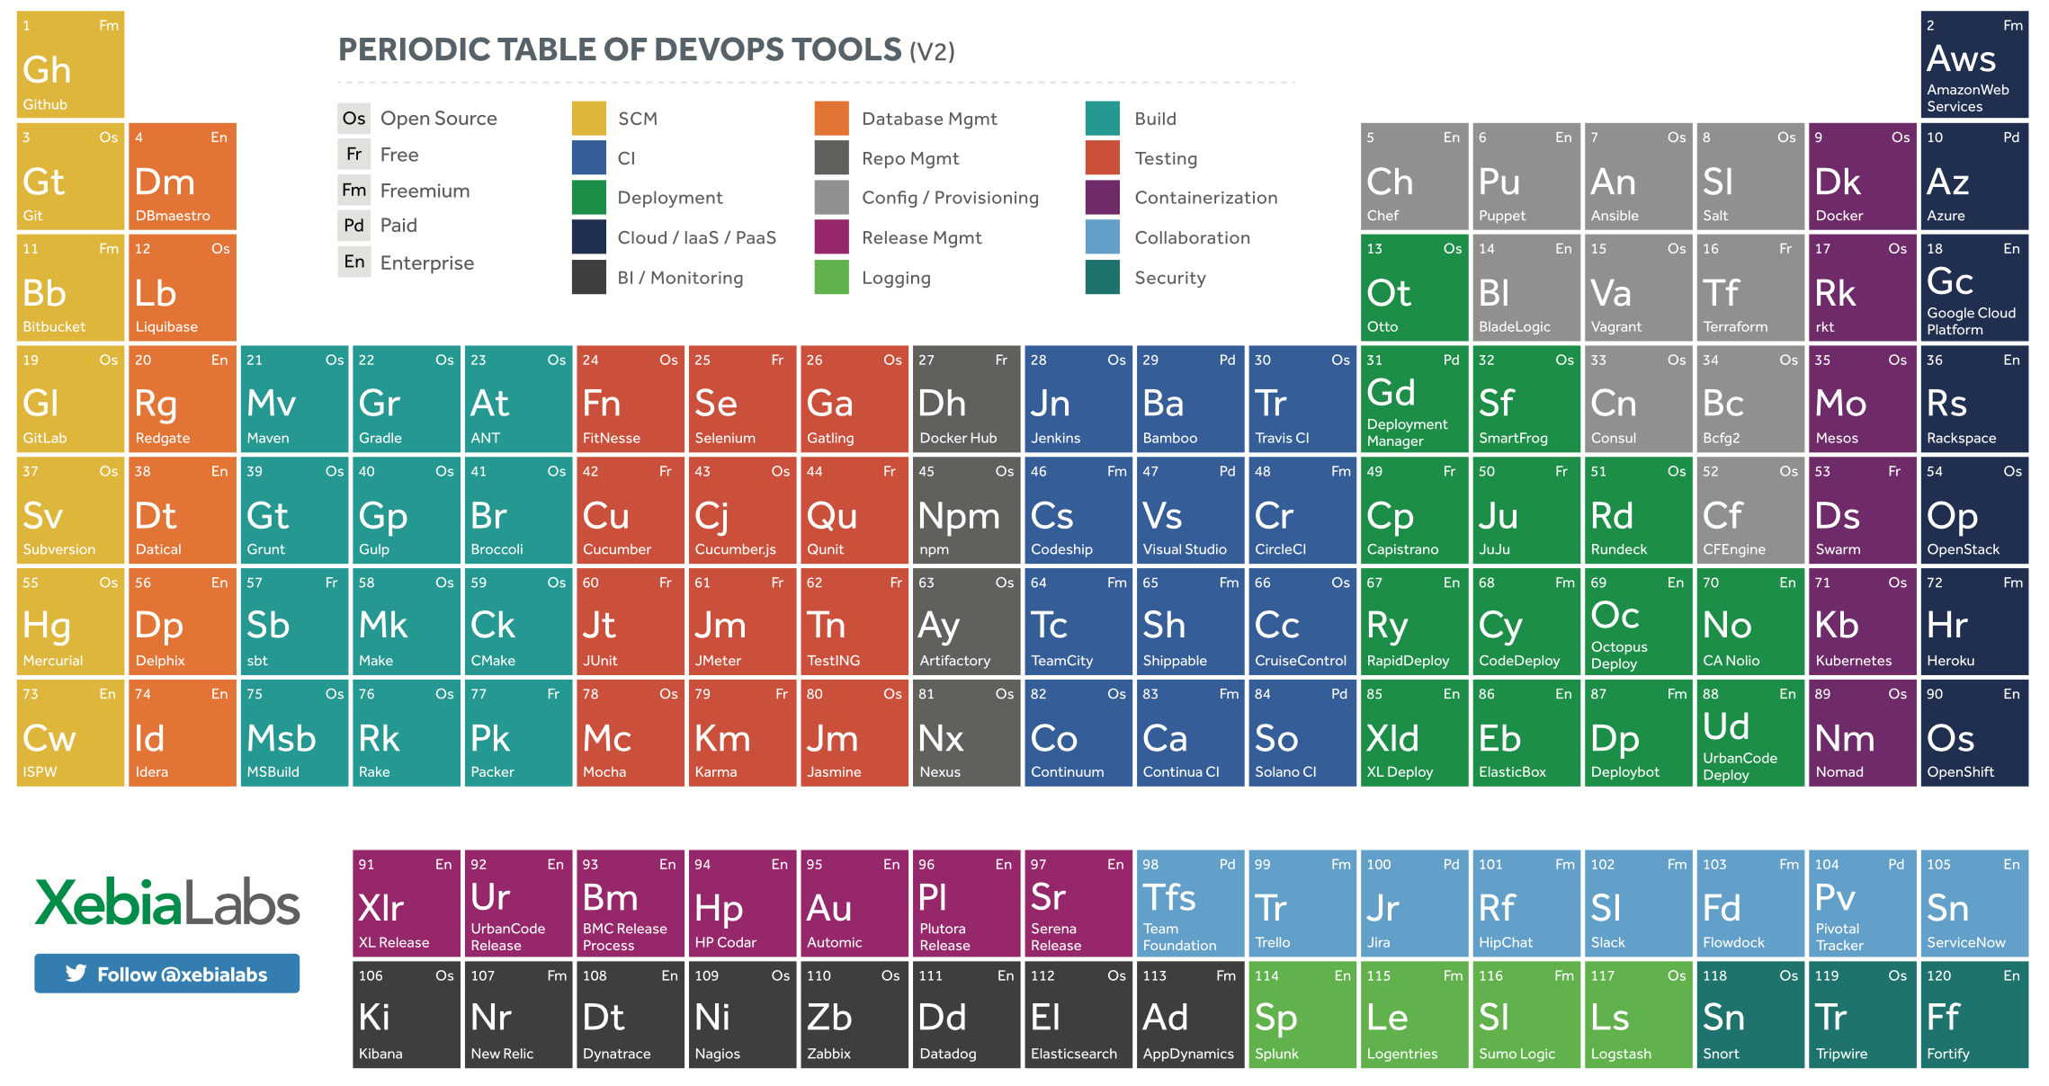
A large number of tools

Slide 13
A large number of tools

Slide 14
One common characteristic
Code! Example 1
To define what a web node should do [Chef]
{
“name”: “web”,
“description”: “Role used for the web tier”,
“chef_type”: “role”,
“json_class”: “Chef::Role”,
“run_list”: [
“recipe[timezone]”,
“recipe[apt]”,
“recipe[nginx]”
],
“default_attributes”: {},
“override_attributes”: {}
}

Slide 15
One common characteristic
Code! Example 2
To run a VM on OpenStack and to install a mongo shell on it [Terraform]
resource "openstack_compute_instance_v2" "mongod_host" {
count = "3"
region = ""
name = "mongod_host"
image_name = "${var.image_name}"
flavor_name = "${var.flavor_name}"
key_pair = "tf-keypair-1"
security_groups = ["mongo_security_group"]
network {
uuid = "${openstack_networking_network_v2.tf_network.id}"
}
...
provisioner "remote-exec" {
scripts = [
"scripts/install_mongo.sh"
"start_mongod.sh"
]
}
}

Slide 16
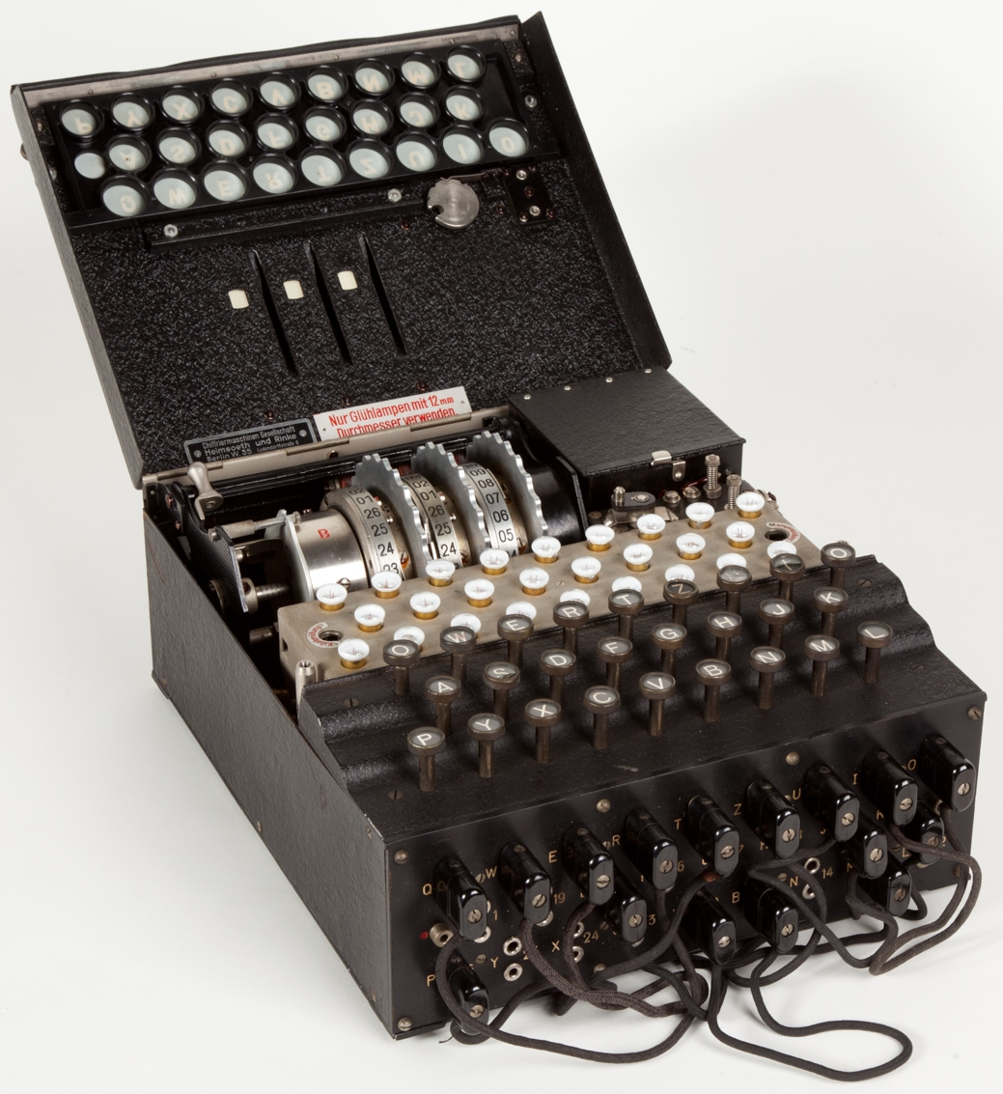
From computation-specific machines
By Alessandro Nassiri - Museo della Scienza e della Tecnologia "Leonardo da Vinci",
CC BY-SA 4.0, https://commons.wikimedia.org/w/index.php?curid=47910919

Slide 17
To programmable machines

Slide 18
To programmable management of machines
To run a VM on OpenStack and to install a mongo shell on it [Terraform]
resource "openstack_compute_instance_v2" "mongod_host" {
count = "3"
region = ""
name = "mongod_host"
image_name = "${var.image_name}"
flavor_name = "${var.flavor_name}"
key_pair = "tf-keypair-1"
security_groups = ["mongo_security_group"]
network {
uuid = "${openstack_networking_network_v2.tf_network.id}"
}
...
provisioner "remote-exec" {
scripts = [
"scripts/install_mongo.sh"
"start_mongod.sh"
]
}
}
Becomes another subject of this same lifecycle
Infrastructure as a Code

Slide 19
Towards standard Infrastructure-as-Code
An Application Deployment Topology, i.e., “a graph of physical artefacts that need support for several lifecycle phases (e.g., procurement, installation, configuration, deployment, undeployment, teardown, etc.)” [6]
Infrastructure
Host
Host
Network
Middleware
Apache
Tomcat
MySQL
Application
Mod_proxy
WAR
Schema

Slide 20
Towards standard Infrastructure-as-Code
Infrastructure-as-code, i.e., “a blueprint detailing physical artefacts, all scripts for all lifecycle phases and all artefacts needed for deployment” [6]
IasC
Blueprint
Infrastructure
Host
Host
Network
Referenced in
IasC Middleware
Scripts (e.g., Chef,
Puppet, etc.)
Middleware
Apache
Tomcat
MySQL
Included in
Deploy artefacts (e.g., JARs, etc.)
Application
Mod_proxy
WAR
Schema

Slide 21
Where Does TOSCA fit into?
Here’s What We’ve Seen there…
An application topology
3 layers
  Infrastructure (Cloud or DC objects)
  Platform or Middleware (App containers)
  Application modules, schemas and configurations
Relationships between components:
  What’s hosted on what or installed on what
  What’s connected to what
Infrastructure
Host
Host
Network
Middleware
Apache
Tomcat
MySQL
Application
Mod_proxy
WAR
Schema

Slide 22
Where Does TOSCA fit into?
Here’s What We’ve Seen there…
An application topology
3 layers
  Infrastructure (Cloud or DC objects)
  Platform or Middleware (App containers)
  Application modules, schemas and configurations
Relationships between components:
  What’s hosted on what or installed on what
  What’s connected to what
Infrastructure
Host
Host
Network
Middleware
Apache
Tomcat
MySQL
Application
Mod_proxy
WAR
Schema
TOSCA: “Topology and Orchestration Specification for Cloud Applications”

Slide 23
Where Does TOSCA fit into?
Here’s What We’ve Seen there…
An application topology
3 layers
  Infrastructure (Cloud or DC objects)
  Platform or Middleware (App containers)
  Application modules, schemas and configurations
Relationships between components:
  What’s hosted on what or installed on what
  What’s connected to what
Infrastructure
Host
Host
Network
Middleware
Apache
Tomcat
MySQL
Application
Mod_proxy
WAR
Schema
TOSCA: “Topology and Orchestration Specification for Cloud Applications”

Slide 24
Where Does TOSCA fit into?
Here’s What We’ve Seen there…
An application topology
3 layers
  Infrastructure (Cloud or DC objects)
  Platform or Middleware (App containers)
  Application modules, schemas and configurations
Relationships between components:
  What’s hosted on what or installed on what
  What’s connected to what
Infrastructure
Host
Host
Network
Middleware
Apache
Tomcat
MySQL
Application
Mod_proxy
WAR
Schema
TOSCA: “Topology and Orchestration Specification for Cloud Applications”

Slide 25
Where Does TOSCA fit into?
Here’s What We’ve Seen there…
Remember this?
1.Configuration Management
2. Server Provisioning
5. Self-Adaptation
3. Application Deployment
4. Monitoring
Infrastructure
Host
Host
Network
Middleware
Apache
Tomcat
MySQL
Application
Mod_proxy
WAR
Schema
TOSCA: “Topology and Orchestration Specification for Cloud Applications”

Slide 26
Where Does TOSCA fit into?
Here’s What We’ve Seen there…
1.Configuration Management
2. Server Provisioning
5. Self-Adaptation
3. Application Deployment
4. Monitoring
Infrastructure
Host
Host
Network
Orchestration!
Middleware
Apache
Tomcat
MySQL
Application
Mod_proxy
WAR
Schema
TOSCA: “Topology and Orchestration Specification for Cloud Applications”

Slide 27
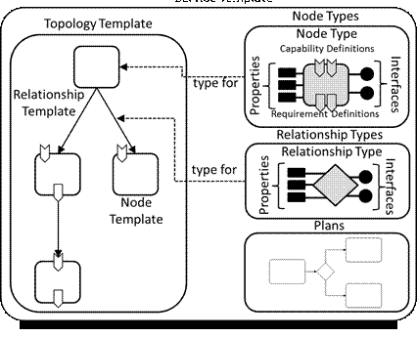
What’s in a TOSCA Topology?
component in the topology are called Nodes
Each Node has a Type (e.g. Host, BD, Web server).
  The Type is abstract and hence portable
  The Type defines Properties and Interfaces
An Interface is a set of hooks (named Operations)
Nodes are connected to one another using Relationships

Slide 28
TOSCA, IasC Standard
TOSCA Service Template [7]

Slide 29
TOSCA Core Ingredients
TOSCA Service Template

Slide 30
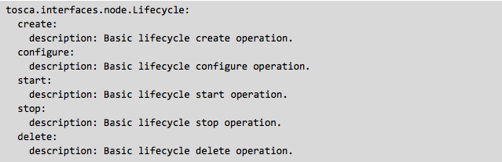
Node Type
Describes a Cloud or Software type (e.g. Server or Apache)
Maps the type to the actual impl. of the lifecycle interface

Slide 31
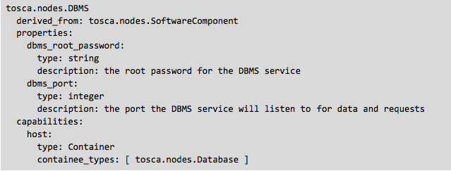
Node Type (cont.)
Defines properties as YAML maps
Might define capabilities (What it can provide to other nodes)

Slide 32
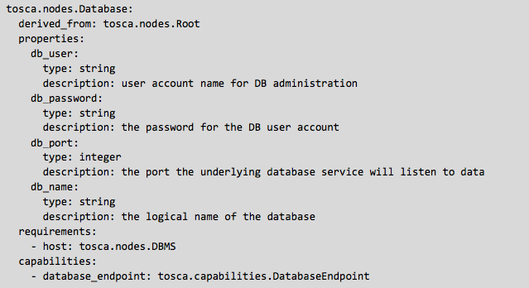
Node Type (cont.)
Might define requirements (what it needs from other nodes)

Slide 33
TOSCA Core Ingredients
TOSCA Service Template

Slide 34

Relationship Type
Requirements and Capabilities are an implicit way to describe relationships
Usually you need the explicit way
  You need hooks to configure the source or target node or both
So relationships have types and interfaces as well

Slide 35
Relationships (cont.)
The basic relationship types are:
  dependsOn – abstract type and its sub types:
  hostedOn – a node is contained within another
  connectsTo – a node has a connection configured to another
The basic interface is configure
  preconfigure_source, preconfigure_target
  postconfigure_source, postconfigure_target
  add_target, remove_target

Slide 36
Node Templates
An instance of a type (like Object to Class)
Has specific properties
Has artifacts:
  What to install
  How to install (mapped to interface hooks)
Has requirements and capabilities (or relationships)

Slide 37
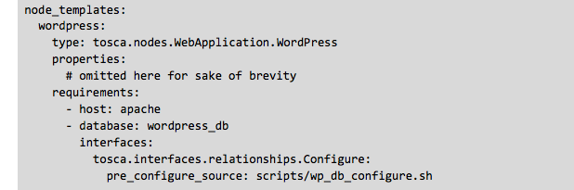
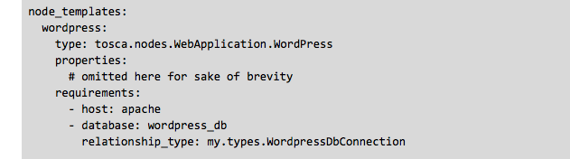
Node Template (Examples)

Slide 38
Translated to TOSCA
Node
Node
“Hosted_on”
relationship
Node
“Connects_to” relationship
Notes:
http://getcloudify.org/guide/3.0/guide-blueprint.html

Slide 40
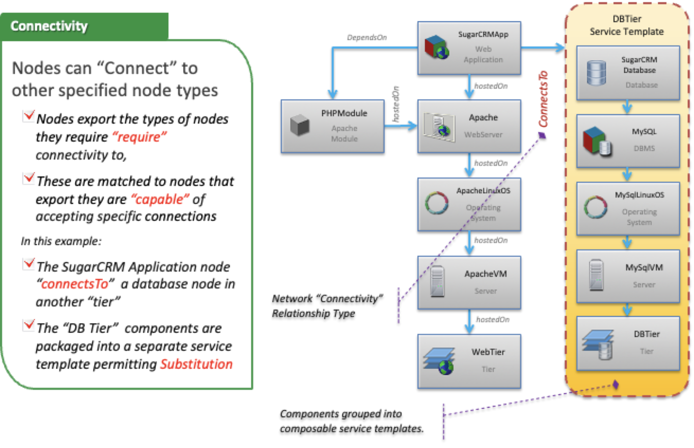

Slide 42
Workflows
Imperative flow algorithm
Using a workflow engine
Timing the invocation of operations on different node
Examples? Any BPMN specification!
But… Considered out of scope for the standard (but currently debated, two factions formed in the TOSCA TC)
Notes:
http://en.wikipedia.org/wiki/Workflow_engine

Slide 43
Policies
Brings monitoring to the orchestration as input
Ongoing evaluation of Rules
Enforce SLA, Health, and anything else
Can invoke more processes
Standard Structure: <Event><Condition><Action>
Standard Types:
  Access-Control;
  Placement;
  QoS (Quality) or (Continuity) CoS;
Example?

Slide 44
TOSCA Policy Example – Entities that compose Policy (Event, Condition, Action) model
Policy Definition
Event Type
<event_type_name>:
derived_from: <parent_event_type>
version: <version_number>
description: <policy_description>
<policy_name>:
type: <policy_type_name>
description: <policy_description>
properties: <property_definitions>
# allowed targets for policy association
targets: [ <list_of_valid_target_templates> ] *
triggers:
<trigger_symbolic_name_1>:
event: <event_type_name>
# TODO: Allow a TOSCA node filter here
# required node (resource) to monitor
target_filter:
node: <node_template_name> <node_type>
# Used to reference another node related to
# the node above via a relationship
requirement: <requirement_name>
# optional capability within node to monitor
capability: <capability_name>
# required clause that compares an attribute
# with the identified node or capability
# for some condition
condition: <constraint_clause>
action:
# a) Define new TOSCA normative strategies
# per-policy type and use here OR
# b) allow domain-specific names
<operation_name>: # (no lifecycle)
# TBD: Do we care about validation of types?
# If so, we should use a TOSCA Lifecycle type
description: <optional description>
inputs: <list of property assignments >
implementation: <script> | <service_name>
<trigger_symbolic_name_2>:
...
<trigger_symbolic_name_n>:
Event
name of a normative
TOSCA Event Type
Condition
described as a constraint of an attribute of the node (or capability) identified by the filter.
Action
Describes either:
a well-known strategy
an implementation artifact (e.g., scripts, service) to invoke
with optional property definitions as inputs (to either choice)
Notes:
44
44

Slide 45
Example Senlin “scaling_out_policy_ceilometer.yaml”
using the Kubernetes “redis” example
Target is a
Kubernetes Pod of the
tosca.groups.placement type
TOSCA Policy Definition
Symbolic name
for the trigger
(could be used to reference an externalized version; however, this would violate a
Policy’s integrity as a
“Security document”
my_scaling_policy:
type: tosca.policies.scaling
properties: # normative TOSCA properties for scaling
min_instances: 1
max_instances: 10
default_instances: 3
increment: 1
# target the policy at the “Pod”
targets: [redis-master-pod ]
triggers:
resize_compute: # symbolic name
event: tosca.events.resource.utilization
target_filter:
node: master-container
requirement: host
capability: Container
condition: utilization greater_than 80%
action:
# map to SENLIN::ACTION::RESIZE
scaleup: # logical operation name
inputs: # optional inputs parameters
number: 1
strategy: BEST_EFFORT
Implementation: <script> | <service_name>
...
TOSCA normative event type (name) that would map to
domain-specific names (e.g., OpenStack Ceilometer)
Find the attribute via the topology:
Navigate to node (directly or via the requirement name) and optionally the Capability name
The condition to map & register with the target monitoring service (e.g., Ceilometer)
Describe NODE to attach an alarm | alert | event to
i.e., Using the “node”, “req”, “cap” and “condition” keys would expressed as a descriptive “filter”
TODO:
Need a % data type
for TOSCA
Note: we combined the Senlin
“Action” of SENLIN:ACTION:RESIZE
with the strategy: BEST_EFFORT to have one name
List optional input parms. here
*more info online
Notes:
45
45
https://www.google.it/url?sa=t&rct=j&q=&esrc=s&source=web&cd=4&ved=0ahUKEwiNn97NrejTAhWBqxoKHUPHB4MQFgg1MAM&url=https%3A%2F%2Fwww.oasis-open.org%2Fcommittees%2Fdownload.php%2F56607%2F2015-09-28%2520TOSCA%2520Policy%2520modeling%2520for%2520Senlin%2520(with%2520Container%2520examples%2520using%2520Kubernetes).pptx&usg=AFQjCNEy8JFMoMQorOuWRLxlb5f3Oe77ZQ&sig2=2UX0tpYxFE-RJLJD99smlw&cad=rja
Senlin is a clustering service (It creates and operates clusters of homogeneous objects exposed by other OpenStack services.) for open-stack clouds

Slide 46
Putting it All Together
tosca.nodes.Root:
description: >
The TOSCA Node Type all other TOSCA base Node Types derive from.
attributes:
tosca_id:
type: string
tosca_name:
type: string
state:
type: string
capabilities:
feature:
type: tosca.capabilities.Node
requirements:
- dependency:
capability: tosca.capabilities.Node
node: tosca.nodes.Root
relationship: tosca.relationships.DependsOn
occurrences: [ 0, UNBOUNDED ]
interfaces:
Standard:
type: tosca.interfaces.node.lifecycle.Standard
tosca.nodes.Compute:
derived_from: tosca.nodes.Root
attributes:
public_address:
required: true
type: string
description: >
The primary public IP address assigned by the cloud provider that applications
may use to access the Compute node.
private_address:
required: true
type: string
description: >
The primary private IP address assigned by the cloud provider that applications
may use to access the Compute node.
networks:
type: map
entry_schema:
type: tosca.datatypes.network.NetworkInfo
ports:
type: map
entry_schema:
type: tosca.datatypes.network.PortInfo
requirements:
- local_storage:
capability: tosca.capabilities.Attachment
node: tosca.nodes.BlockStorage
relationship: tosca.relationships.AttachTo
occurrences: [0, UNBOUNDED]
capabilities:
host:
type: tosca.capabilities.Container
binding:
type: tosca.capabilities.network.Bindable
os:
type: tosca.capabilities.OperatingSystem
scalable:
type: tosca.capabilities.Scalable
tosca.nodes.SoftwareComponent:
derived_from: tosca.nodes.Root
properties:
# domain-specific software component version
component_version:
type: version
required: false
requirements:
- host:
capability: tosca.capabilities.Container
node: tosca.nodes.Compute
relationship: tosca.relationships.HostedOn
tosca.nodes.DBMS:
derived_from: tosca.nodes.SoftwareComponent
properties:
port:
required: false
type: integer
description: >
The port the DBMS service will listen to for data and requests.
root_password:
required: false
type: string
description: >
The root password for the DBMS service.
capabilities:
host:
type: tosca.capabilities.Container
valid_source_types: [tosca.nodes.Database]
tosca.nodes.Database:
derived_from: tosca.nodes.Root
properties:
user:
required: false
type: string
description: >
User account name for DB administration
name:
required: false
type: string
description: >
The name of the database.
password:
required: false
type: string
description: >
The password for the DB user account
requirements:
- host:
capability: tosca.capabilities.Container
node: tosca.nodes.DBMS
relationship: tosca.relationships.HostedOn
capabilities:
database_endpoint:
type: tosca.capabilities.DatabaseEndpoint
tosca.nodes.WebServer:
derived_from: tosca.nodes.SoftwareComponent
capabilities:
data_endpoint:
type: tosca.capabilities.Endpoint
admin_endpoint:
type: tosca.capabilities.Endpoint.Admin
host:
type: tosca.capabilities.Container
valid_source_types: [tosca.nodes.WebApplication]
tosca.nodes.WebApplication:
derived_from: tosca.nodes.Root
properties:
context_root:
type: string
requirements:
- host:
capability: tosca.capabilities.Container
node: tosca.nodes.WebServer
relationship: tosca.relationships.HostedOn
capabilities:
app_endpoint:
type: tosca.capabilities.Endpoint
tosca.nodes.BlockStorage:
derived_from: tosca.nodes.Root
properties:
size:
type: integer
constraints:
- greater_or_equal: 1 MB
volume_id:
type: string
required: false
snapshot_id:
type: string
required: false
attributes:
volume_id:
type: string
capabilities:
attachment:
type: tosca.capabilities.Attachment
tosca.nodes.network.Network:
derived_from: tosca.nodes.Root
description: >
The TOSCA Network node represents a simple, logical network service.
properties:
ip_version:
type: integer
required: false
default: 4
constraints:
- valid_values: [ 4, 6 ]
description: >
The IP version of the requested network. Valid values are 4 for ipv4
or 6 for ipv6.
cidr:
type: string
required: false
description: >
The cidr block of the requested network.
start_ip:
type: string
required: false
description: >
The IP address to be used as the start of a pool of addresses within
the full IP range derived from the cidr block.
end_ip:
type: string
required: false
description: >
The IP address to be used as the end of a pool of addresses within
the full IP range derived from the cidr block.
gateway_ip:
type: string
required: false
description: >
The gateway IP address.
network_name:
type: string
required: false
description: >
An identifier that represents an existing Network instance in the
underlying cloud infrastructure or can be used as the name of the
newly created network. If network_name is provided and no other
properties are provided (with exception of network_id), then an
existing network instance will be used. If network_name is provided
alongside with more properties then a new network with this name will
be created.
network_id:
type: string
required: false
description: >
An identifier that represents an existing Network instance in the
underlying cloud infrastructure. This property is mutually exclusive
with all other properties except network_name. This can be used alone
or together with network_name to identify an existing network.
segmentation_id:
type: string
required: false
description: >
A segmentation identifier in the underlying cloud infrastructure.
E.g. VLAN ID, GRE tunnel ID, etc..
dhcp_enabled:
type: boolean
required: false
default: true
description: >
Indicates should DHCP service be enabled on the network or not.
capabilities:
link:
type: tosca.capabilities.network.Linkable
tosca.nodes.network.Port:
derived_from: tosca.nodes.Root
description: >
The TOSCA Port node represents a logical entity that associates between
Compute and Network normative types. The Port node type effectively
represents a single virtual NIC on the Compute node instance.
properties:
ip_address:
type: string
required: false
description: >
Allow the user to set a static IP.
order:
type: integer
required: false
default: 0
constraints:
- greater_or_equal: 0
description: >
The order of the NIC on the compute instance (e.g. eth2).
is_default:
type: boolean
required: false
default: false
description: >
If is_default=true this port will be used for the default gateway
route. Only one port that is associated to single compute node can
set as is_default=true.
ip_range_start:
type: string
required: false
description: >
Defines the starting IP of a range to be allocated for the compute
instances that are associated with this Port.
ip_range_end:
type: string
required: false
description: >
Defines the ending IP of a range to be allocated for the compute
instances that are associated with this Port.
attributes:
ip_address:
type: string
requirements:
- binding:
capability: tosca.capabilities.network.Bindable
description: >
Binding requirement expresses the relationship between Port and
Compute nodes. Effectevely it indicates that the Port will be
attached to specific Compute node instance
- link:
capability: tosca.capabilities.network.Linkable
description: >
Link requirement expresses the relationship between Port and Network
nodes. It indicates which network this port will connect to.
tosca.nodes.ObjectStorage:
derived_from: tosca.nodes.Root
properties:
store_name:
type: string
store_size:
type: scalar-unit.size
constraints:
- greater_or_equal: 0 GB
store_maxsize:
type: scalar-unit.size
constraints:
- greater_or_equal: 0 GB
capabilities:
storage_endpoint:
type: tosca.capabilities.Endpoint
##########################################################################
# Relationship Type.
# A Relationship Type is a reusable entity that defines the type of one
# or more relationships between Node Types or Node Templates.
##########################################################################
tosca.relationships.Root:
description: >
The TOSCA root Relationship Type all other TOSCA base Relationship Types derive from.
attributes:
tosca_id:
type: string
tosca_name:
type: string
interfaces:
Configure:
type: tosca.interfaces.relationship.Configure
tosca.relationships.DependsOn:
derived_from: tosca.relationships.Root
valid_target_types: [ tosca.capabilities.Node ]
tosca.relationships.HostedOn:
derived_from: tosca.relationships.Root
valid_target_types: [ tosca.capabilities.Container ]
tosca.relationships.ConnectsTo:
derived_from: tosca.relationships.Root
valid_target_types: [ tosca.capabilities.Endpoint ]
tosca.relationships.AttachTo:
derived_from: tosca.relationships.Root
valid_target_types: [ tosca.capabilities.Attachment ]
properties:
location:
required: true
type: string
constraints:
- min_length: 1
device:
required: false
type: string
tosca.relationships.network.LinksTo:
derived_from: tosca.relationships.DependsOn
valid_target_types: [ tosca.capabilities.network.Linkable ]
tosca.relationships.network.BindsTo:
derived_from: tosca.relationships.DependsOn
valid_target_types: [ tosca.capabilities.network.Bindable ]
##########################################################################
# Capability Type.
# A Capability Type is a reusable entity that describes a kind of
# capability that a Node Type can declare to expose.
##########################################################################
tosca.capabilities.Root:
description: >
The TOSCA root Capability Type all other TOSCA base Capability Types derive from.
tosca.capabilities.Node:
derived_from: tosca.capabilities.Root
tosca.capabilities.Container:
derived_from: tosca.capabilities.Root
properties:
num_cpus:
required: false
type: integer
constraints:
- greater_or_equal: 1
description: >
Number of (actual or virtual) CPUs associated with the Compute node.
cpu_frequency:
type: scalar-unit.frequency
required: false
constraints:
- greater_or_equal: 0.1 GHz
disk_size:
required: false
type: scalar-unit.size
constraints:
- greater_or_equal: 0 MB
description: >
Size of the local disk, available to applications running on the
Compute node.
mem_size:
required: false
type: scalar-unit.size
constraints:
- greater_or_equal: 0 MB
description: >
Size of memory, available to applications running on the Compute node.
tosca.capabilities.Endpoint:
derived_from: tosca.capabilities.Root
properties:
protocol:
type: string
default: tcp
port:
type: PortDef
required: false
secure:
type: boolean
default: false
url_path:
type: string
required: false
port_name:
type: string
required: false
network_name:
type: string
required: false
initiator:
type: string
default: source
constraints:
- valid_values: [ source, target, peer ]
ports:
type: map
required: false
constraints:
- min_length: 1
entry_schema:
type: tosca.datatypes.network.PortSpec
attributes:
public_address:
type: string
private_address:
type: string
tosca.capabilities.Endpoint.Admin:
derived_from: tosca.capabilities.Endpoint
# Change Endpoint secure indicator to true from its default of false
properties:
secure:
default: true
tosca.capabilities.Endpoint.Database:
derived_from: tosca.capabilities.Endpoint
tosca.capabilities.Attachment:
derived_from: tosca.capabilities.Root
tosca.capabilities.network.Linkable:
derived_from: tosca.capabilities.Root
description: >
A node type that includes the Linkable capability indicates that it can
be pointed by tosca.relationships.network.LinksTo relationship type, which
represents an association relationship between Port and Network node types.
tosca.capabilities.network.Bindable:
derived_from: tosca.capabilities.Root
description: >
A node type that includes the Bindable capability indicates that it can
be pointed by tosca.relationships.network.BindsTo relationship type, which
represents a network association relationship between Port and Compute node
types.
tosca.capabilities.OperatingSystem:
derived_from: tosca.capabilities.Root
properties:
architecture:
required: true
default: x86_64
type: string
description: >
The host Operating System (OS) architecture.
type:
required: true
type: string
description: >
The host Operating System (OS) type.
distribution:
required: false
type: string
description: >
The host Operating System (OS) distribution. Examples of valid values
for an “type” of “Linux” would include:
debian, fedora, rhel and ubuntu.
version:
required: false
type: string
description: >
The host Operating System version.
tosca.capabilities.Scalable:
derived_from: tosca.capabilities.Root
properties:
min_instances:
type: integer
required: true
default: 1
max_instances:
type: integer
required: true
default: 1
default_instances:
type: integer
required: false
description: >
The value for this property MUST be in the range between the values
set for min_instances and max_instances properties.
##########################################################################
# Interfaces Type.
# The Interfaces element describes a list of one or more interface
# definitions for a modelable entity (e.g., a Node or Relationship Type)
# as defined within the TOSCA Simple Profile specification.
##########################################################################
tosca.interfaces.node.lifecycle.Standard:
create:
description: Standard lifecycle create operation.
configure:
description: Standard lifecycle configure operation.
start:
description: Standard lifecycle start operation.
stop:
description: Standard lifecycle stop operation.
delete:
description: Standard lifecycle delete operation.
tosca.interfaces.relationship.Configure:
pre_configure_source:
description: Operation to pre-configure the source endpoint.
pre_configure_target:
description: Operation to pre-configure the target endpoint.
post_configure_source:
description: Operation to post-configure the source endpoint.
post_configure_target:
description: Operation to post-configure the target endpoint.
add_target:
description: Operation to add a target node.
remove_target:
description: Operation to remove a target node.
add_source:
description: Operation to notify the target node of a source node which is now available via a relationship.
description:
target_changed:
description: Operation to notify source some property or attribute of the target changed
##########################################################################
# Data Type.
# A Datatype is a complex data type declaration which contains other
# complex or simple data types.
##########################################################################
tosca.datatypes.network.NetworkInfo:
properties:
network_name:
type: string
network_id:
type: string
addresses:
type: list
entry_schema:
type: string
tosca.datatypes.network.PortInfo:
properties:
port_name:
type: string
port_id:
type: string
network_id:
type: string
mac_address:
type: string
addresses:
type: list
entry_schema:
type: string
tosca.datatypes.network.PortDef:
type: integer
constraints:
- in_range: [ 1, 65535 ]
tosca.datatypes.network.PortSpec:
properties:
protocol:
type: string
required: true
default: tcp
constraints:
- valid_values: [ udp, tcp, igmp ]
target:
type: list
entry_schema:
type: PortDef
target_range:
type: range
constraints:
- in_range: [ 1, 65535 ]
source:
type: list
entry_schema:
type: PortDef
source_range:
type: range
constraints:
- in_range: [ 1, 65535 ]
tosca.datatypes.network.Credential:
properties:
protocol:
type: string
token_type:
type: string
token:
type: string
keys:
type: map
entry_schema:
type: string
tosca_definitions_version: tosca_simple_yaml_1_0_0
description: >
This TOSCA simple profile deployes nodejs, mongodb, elasticsearch, logstash and kibana each on a separate server
with monitoring enabled for nodejs server where a sample nodejs application is running. The syslog and collectd are
insatlled on a nodejs server.
imports:
- tosca_base_type_definition.yaml
- paypalpizzastore_nodejs_app.yaml
- elasticsearch.yaml
- logstash.yaml
- kibana.yaml
- collectd.yaml
- rsyslog.yaml
dsl_definitions:
host_capabilities: &host_capabilities
# container properties (flavor)
disk_size: 10 GB
num_cpus: { get_input: my_cpus }
mem_size: 4096 MB
os_capabilities: &os_capabilities
architecture: x86_64
type: Linux
distribution: Ubuntu
version: 14.04
topology_template:
inputs:
my_cpus:
type: integer
description: Number of CPUs for the server.
constraints:
- valid_values: [ 1, 2, 4, 8 ]
…
TOSCA Template contains:
  Application Topology
    Nodes
      Interfaces
      Properties
      Artifacts (Plugins in Cloudify)
    Relationships
      Interfaces
  Workflows
  Policies

Slide 47
TOSCA YAML IasC Maintenance & Evolution Examples: Sample Applications
WordPress+MySQL
NodeJS App+MongoDB

Slide 48
WebServer-DBMS-1:
WordPress - MySQL
wordpress
mysql_database
WebApplication
Database
Properties
context_root:
ConnectsTo
Properties
password
user
port
name
Requirements
Requirements
Endpoint.DB
Container
Container
Capabilities
Endpoint.DB
name
HostedOn
WebServer
mysql_dbms
Properties
component_version:
admin_credential:
DBMS
HostedOn
Properties
component_version
admin_credential
root_password
port
Capabilities
Container
Capabilities
Requirements
Container
Container
Requirements
Container
server
HostedOn
Compute
HostedOn
Capabilities
Container

Slide 49
WebServer-DBMS-3:
Nodejs - MongoDB
GitHub
Repo.
paypal_sample
mongo_database
WebApplication
Database
Properties
context_root:
ConnectsTo
Properties
password
user
port
name
Requirements
Requirements
Endpoint.DB
Container
Artifacts:
nodejs_sample_app
Container
Capabilities
Endpoint.DB
nodejs
HostedOn
WebServer
mongo_dbms
Artifacts
nodejs_sample_app
DBMS
HostedOn
Properties
port
Capabilities
Capabilities
Container
Container
Requirements
Requirements
Container
Container
app_server
HostedOn
mongo_server
HostedOn
Compute
Compute
Capabilities
Capabilities
Container
Container

Slide 50
Block Storage 1: Using the normative AttachesTo Relationship Type
my_server
Compute
Attributes
private_address
public_address
networks
ports
Capabilities
my_storage
Container
OperatingSystem
BlockStorage
Scalable
Capabilities
Properties
size
volume_id
snapshot_id
Bindable
AttachesTo
Attachment
Endpoint
Requirements
Attachment

Slide 51
Block Storage 2: Using a custom AttachesTo Relationship Type
my_server
Compute
Attributes
private_address
public_address
networks
ports
Capabilities
my_storage
Container
OperatingSystem
BlockStorage
Scalable
Capabilities
Properties
size
volume_id
snapshot_id
Bindable
MyCustomAttachesTo
Attachment
Endpoint
Requirements
Attachment

Slide 52
Block Storage 3: Using a Relationship Template of type AttachesTo
my_server
Compute
Attributes
private_address
public_address
networks
ports
Capabilities
my_storage
Container
OperatingSystem
BlockStorage
Scalable
storage_attachment
Capabilities
Properties
size
volume_id
snapshot_id
Bindable
AttachesTo
Attachment
Endpoint
Requirements
Attachment

Slide 53
Block Storage 4:
Single Block Storage shared by 2-Tier Application with
custom AttachesTo Type and implied relationships
my_web_app_tier_1
Compute
Attributes
private_address
public_address
networks
ports
Capabilities
…
MyAttachesTo
Properties
location:
/default_location
Requirements
my_storage
Attachment
BlockStorage
Capabilities
Properties
size
volume_id
snapshot_id
my_web_app_tier_2
Attachment
Compute
MyAttachesTo
Attributes
private_address
public_address
networks
ports
Properties
location:
/some_other_data_location
Capabilities
…
Requirements
Attachment

Slide 54
Block Storage 5:
Single Block Storage shared by 2-Tier Application
with custom AttachesTo Type and explicit Relationship Templates
my_web_app_tier_1
Compute
Attributes
private_address
public_address
networks
ports
Capabilities
storage_attachesto_1
…
MyAttachesTo
Properties
location:
/my_data_location
Requirements
my_storage
Attachment
BlockStorage
Capabilities
Properties
size
volume_id
snapshot_id
my_web_app_tier_2
storage_attachesto_2
Attachment
Compute
MyAttachesTo
Attributes
private_address
public_address
networks
ports
Properties
location:
/some_other_data_location
Capabilities
…
Requirements
Attachment

Slide 55
Block Storage 6:
Multiple Block Storage attached to different Servers
my_server
my_storage
Compute
AttachesTo
BlockStorage
Attributes
private_address
public_address
networks
ports
Capabilities
Properties
location: <input>
…
Capabilities
Properties
size
volume_id
snapshot_id
Attachment
Requirements
Attachment
my_server2
my_storage2
Compute
AttachesTo
BlockStorage
Attributes
private_address
public_address
networks
ports
Capabilities
Properties
location: <input>
…
Capabilities
Properties
size
volume_id
snapshot_id
Attachment
Requirements
Attachment

Slide 56
ObjectStorage 1:
Creating an Object Storage service
obj_store_server
ObjectStorage
Properties
name: <input>
size: <input>
maxsize: <input>
Capabilities
Endpoint

Slide 57
Network 1:
Server bound to a new network
my_server
Compute
Attributes
private_address
public_address
networks
ports
my_port
Port
my_network
Capabilities
BindsTo
Bindable
Requirements
Network
Bindable
Properties
network_name: <input>
ip_version: 4
cidr: '192.168.0.0/24‘
start_ip: '192.168.0.50‘
end_ip: '192.168.0.200‘
gateway_ip: '192.168.0.1'
LinksTo
Linkable
Capabilities
Linkable

Slide 58
Network 2:
Server bound to an existing network
my_server
Compute
Attributes
private_address
public_address
networks
ports
my_port
Port
my_network
Capabilities
BindsTo
Bindable
Requirements
Network
Bindable
Properties
network_name: <input>
LinksTo
Linkable
Capabilities
Linkable

Slide 59
Network 3:
Two servers bound to a single network
my_server
my_port
Compute
Port
Attributes
…
Requirements
my_network
BindsTo
Bindable
Capabilities
Network
Bindable
Linkable
LinksTo
Properties
network_name: <input>
…
Capabilities
my_server2
my_port2
Linkable
Compute
Port
Attributes
…
BindsTo
Requirements
LinksTo
Capabilities
Bindable
Bindable
Linkable

Slide 60
Network 3:
Two servers bound to a single network
my_port1
my_network1
Port
Network
Properties
…
my_server
Requirements
Bindable
LinksTo
Capabilities
Compute
BindsTo
Linkable
Linkable
Attributes
…
my_port2
my_network2
Capabilities
Bindable
Port
Network
BindsTo
Properties
…
Requirements
Bindable
LinksTo
Capabilities
Linkable
Linkable
my_port3
my_network3
BindsTo
Network
Port
Properties
…
Requirements
LinksTo
Bindable
Capabilities
Linkable
Linkable

Slide 61
WebServer-DBMS-1:
WordPress - MySQL
wordpress
mysql_database
WebApplication
Database
Properties
context_root:
ConnectsTo
Properties
password
user
port
name
Requirements
Requirements
Endpoint.DB
Container
Container
Capabilities
Endpoint.DB
name
HostedOn
WebServer
mysql_dbms
Properties
component_version:
admin_credential:
DBMS
HostedOn
Properties
component_version
admin_credential
root_password
port
Capabilities
Container
Capabilities
Requirements
Container
Container
Requirements
Container
server
HostedOn
Compute
HostedOn
Capabilities
Container

Slide 62
WebServer-DBMS-3:
Nodejs - MongoDB
GitHub
Repo.
paypal_sample
mongo_database
WebApplication
Database
Properties
context_root:
ConnectsTo
Properties
password
user
port
name
Requirements
Requirements
Endpoint.DB
Container
Artifacts:
nodejs_sample_app
Container
Capabilities
Endpoint.DB
nodejs
HostedOn
WebServer
mongo_dbms
Artifacts
nodejs_sample_app
DBMS
HostedOn
Properties
port
Capabilities
Capabilities
Container
Container
Requirements
Requirements
Container
Container
app_server
HostedOn
mongo_server
HostedOn
Compute
Compute
Capabilities
Capabilities
Container
Container

Slide 63
Exploring Containment in TOSCA: Modeling WebServer with Compute
Effectively…
Compute is a Container (Node Type)
WebServer (i.e. a child of SoftwareComponent) is both a Container and Containee (Node Type)
Software Component
(Container + Containee)
Artifacts
Apache.TAR
scripts
WebServer
Capabilities
Container
Requirements
capabilities:
host:
type: tosca.capabilities.Container
valid_source_types: [ tosca.nodes.WebApplication ]
Container
Compute
(Container)
HostedOn
requirements:
- host:
capability: tosca.capabilities.Container
node: tosca.nodes.Compute
relationship: tosca.relationships.HostedOn
Capabilities
Container
Properties
num_cpus
mem_size
disk_size
Scalable
OpSys
capabilities:
host:
type: tosca.capabilities.Container
valid_source_types: [tosca.nodes.SoftwareComponent]

Slide 64
Modeling Container-Containee like Compute-Software Component
Expressing “Docker” as a Capability Type
IaaS
Modeling
Compute is explicit or implicit
PaaS
Modeling
Container is explicit or implicit
Agnostic
Cloud Foundry
Azure
Artifacts
Docker Image
(Apache.TAR)
Software Component
(Container + Containee)
Containee
(Docker Runtime Requirement)
b
Requirements
artifacts:
- image:
mime_type: Docker
repo: xxx
URI: xxx
WebServer
Docker
Capabilities
Container
Container
Requirements
Container
Compute
(Container)
Software Component
requirements:
- host:
capability: tosca.capabilities.Container
# node: NULL *
relationship: tosca.relationships.HostedOn
Capabilities
Container
(Docker Runtime Capability)
Container
Hosted On
Hosted On
Scalable
Requirements
Capabilities
OpSys
Container
Docker
Container
capabilities:
host:
type: tosca.capabilities.Container
# valid_source_types: [NULL *]
directive: substitutable
* “Effectively NULL”, not actually a NULL value.
meaning, we do not need to bind to a Node Type

Slide 65
Opaque Containee Implementation: Providing Docker “image” as an artifact
Use Case 1: Docker Image (with WebServer inside) as a TOSCA Artifact in CSAR file
TOSCA CSAR File
PaaS
Modeling
Container is explicit or implicit
Artifacts
Docker Image
(Apache.TAR)
Containee
(Docker Runtime Requirement)
Software Component
Container
(Docker Runtime Capability)
Requirements
artifact_types:
# NEW Tosca non-normative type
tosca.artifacts.impl.Docker.Image:
derived_from: tosca.artifacts.Root
description: Docker Image TAR
mime_type: TBD
file_ext: [ tar ]
Container
Hosted On
Capabilities
Docker
Rocket
…
Container
node_templates:
docker_webserver:
type: tosca.nodes.Containee
capabilities:
# TBD
requirements:
- host:
capability: tosca.capabilities.Container
relationship: tosca.relationships.HostedOn
target_filter:
capabilities:
- tosca.capabilities.Container.Docker
properties:
...
artifacts:
# Docker image is in CSAR file
- my_image: files/docker_webserver_content.tar
type: tosca.artifacts.impl.Docker.Image:
node_templates:
# Note: this node represents just the Docker
# client in a PaaS, BUT also the engine
# (daemon) for single client / demo purposes
docker_client:
type: tosca.nodes.Container
capabilities:
tosca.capabilities.Container.Docker
# Optionally… make this an abstract
# node_template, allowing subsystem
# replacement:
directive: [ selectable ]

Slide 66

Opaque Containee Implementation: Providing Docker “image” as an artifact
Use Case 3: Docker Image (with WebServer inside) in a “Docker” Repo.
PaaS
Modeling
Container is explicit or implicit
Artifacts
Docker Image
.TAR)
Docker Hub
(Repo.)
Containee
(Docker Runtime Requirement)
URI of DockerImage
Relative to Repo.
artifact_types:
tosca.artifacts.impl.Docker.Image:
derived_from: tosca.artifacts.Root
description: Docker Image TAR
mime_type: TBD
file_ext: [ tar ]
Software Component
Requirements
Container
(Docker Runtime Capability)
Container
Hosted On
Capabilities
Docker
Rocket
# NOT YET IN TOSCA SPEC. TO BE INVENTED…
repositories:
docker_hub:
url: xxx
credentials: yyy
node_templates:
docker_webserver:
type: tosca.nodes.Containee
requirements:
- host:
# omitted for brevity
artifacts:
- my_image: < URI of Docker Image in Repo. >
type: tosca.artifacts.impl.Docker.Image:
repository: docker_repo
…
Container

Slide 67
Opaque Containee Implementation: Providing Docker “image” as an artifact
Use Case 3: Dynamically “build” Docker Image using multiple repositories, single Node Template
(IN-PROGRESS)
Artifacts
Guest OS (TAR)
Docker Hub
(Repo.)
PaaS
Modeling
Container is explicit or implicit
Containee
(Docker Runtime Requirement)
URIs of components
Relative to Repos.
Artifacts
Apache Repo
Software Component
Apache
(Repo.)
Container
(Docker Runtime Capability)
Requirements
Container
Hosted On
Capabilities
Artifacts
Pizza App
Docker
Rocket
Pizza Store App
(Repo.)
…
# NOT YET IN TOSCA SPEC. TO BE INVENTED…
repositories:
docker_hub: ...
apache_repo: ...
paypal_repo: ...
node_templates:
docker_os_webserver_app:
type: tosca.nodes.Containee
requirements:
- host:
# omitted for brevity
artifacts:
- my_guest_os_image: ...
- my_apache_server: ...
- my_pizza_app: ...
Container

Slide 68
Opaque Containee Implementation: Providing Docker “image” as an artifact
Use Case 4: Dynamically “build” Docker Image using multiple repositories, Multiple Node templates
(IN-PROGRESS)
Artifacts
Guest OS
Docker Hub
(Repo.)
Containee
(Docker Runtime Requirement)
PaaS
Modeling
Container is explicit or implicit
URIs of components
Relative to Repos.
Capabilities
Artifacts
Apache Repo
OS
Apache
(Repo.)
Software Component
WebServer
Container
(Docker Runtime Capability)
Requirements
Container
Hosted On
WebApp
Capabilities
Artifacts
Pizza App
Docker
Rocket
…
Container
Pizza Store
App
(Repo.)
# NOT YET IN TOSCA SPEC. TO BE INVENTED…
repositories:
apache_repo: ...
node_templates:
TBD
# NOT YET IN TOSCA SPEC. TO BE INVENTED…
repositories:
docker_hub: ...
node_templates:
docker_webserver:
type: tosca.nodes.Containee
requirements:
- host:
# omitted for brevity
artifacts:
- my_guest_os_image: ...
# NOT YET IN TOSCA SPEC. TO BE INVENTED…
repositories:
paypal_repo: ...
node_templates:
TBD

Slide 69
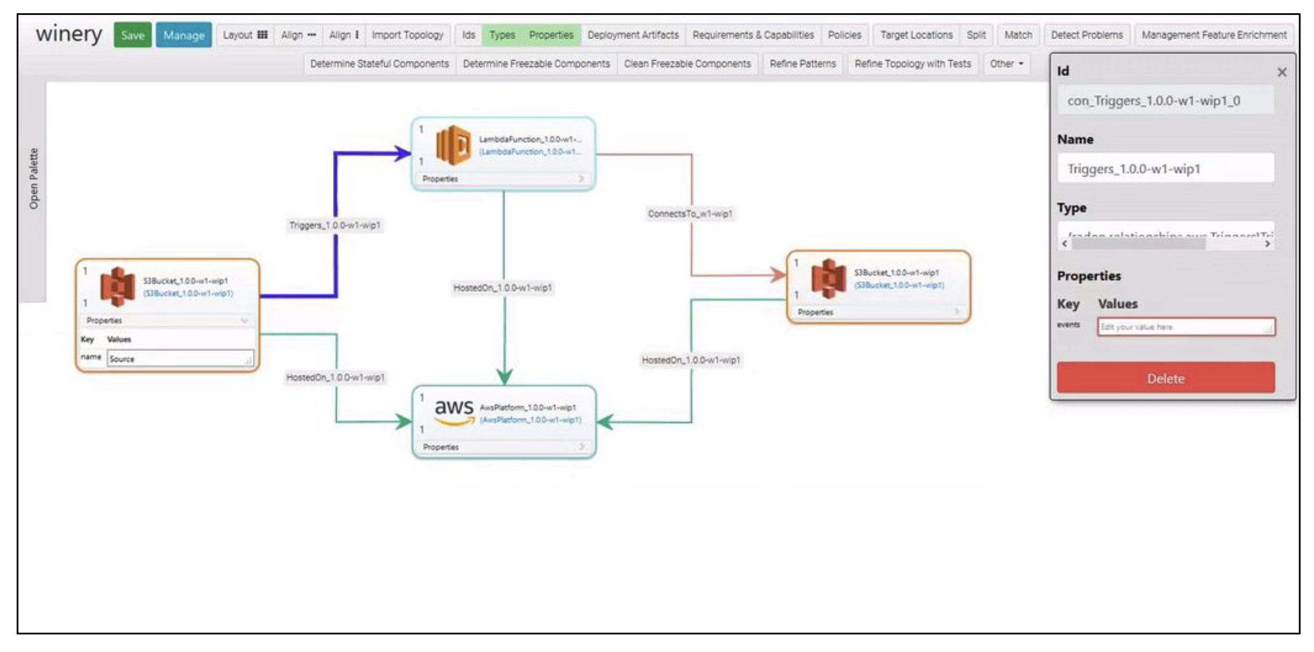
Can I draw those fancy diagrams with autogenerated TOSCA IaC?

Slide 70
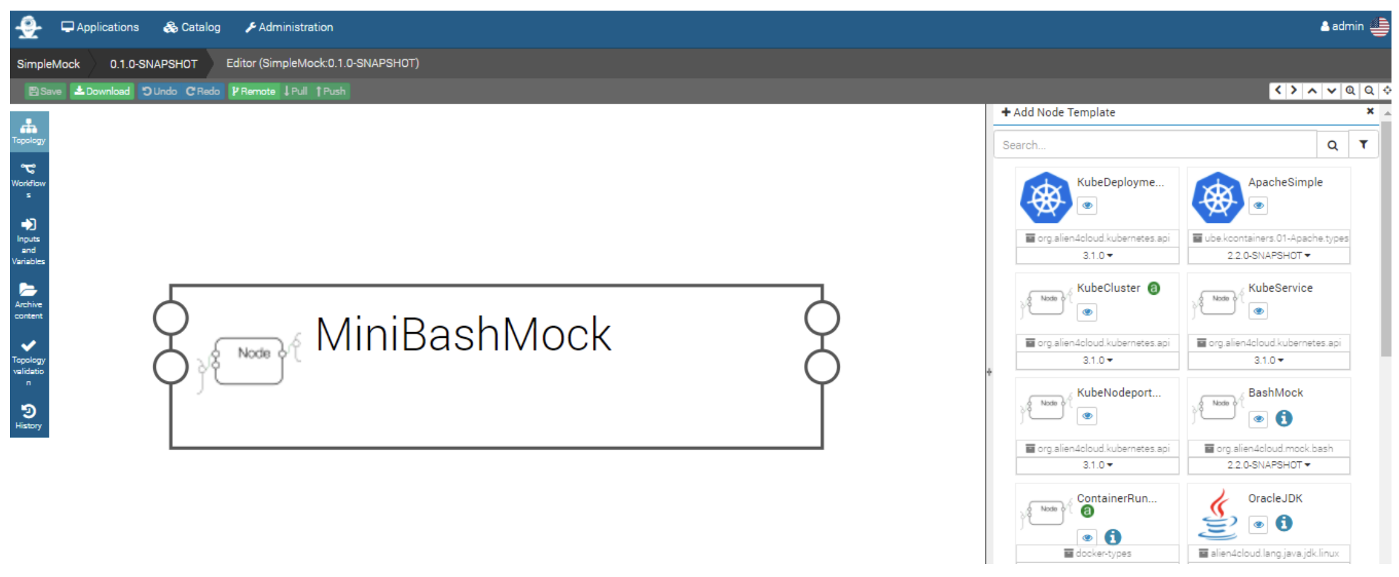

Slide 71
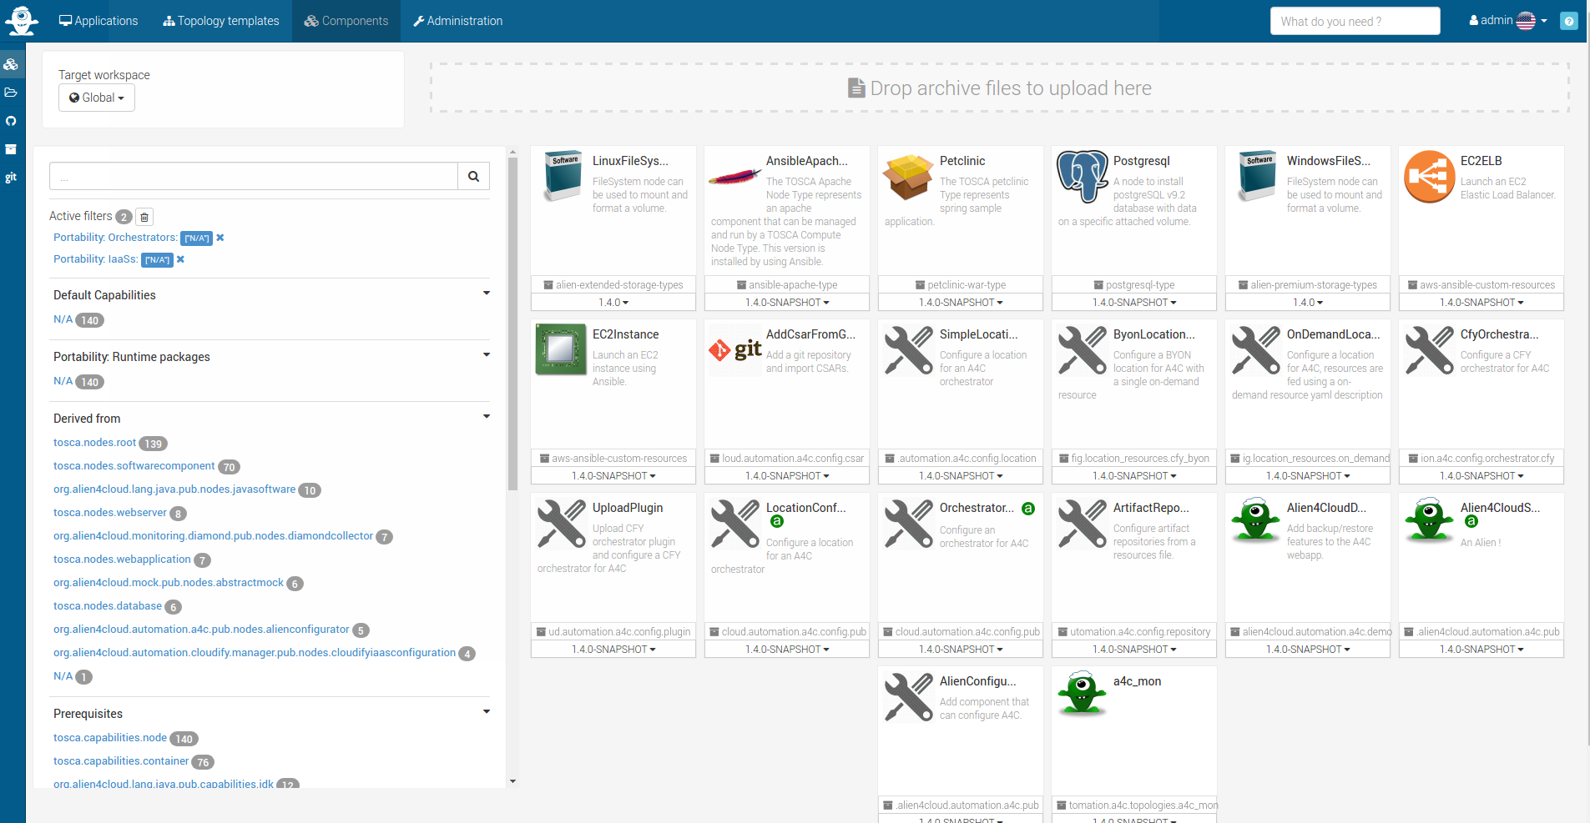

Slide 72
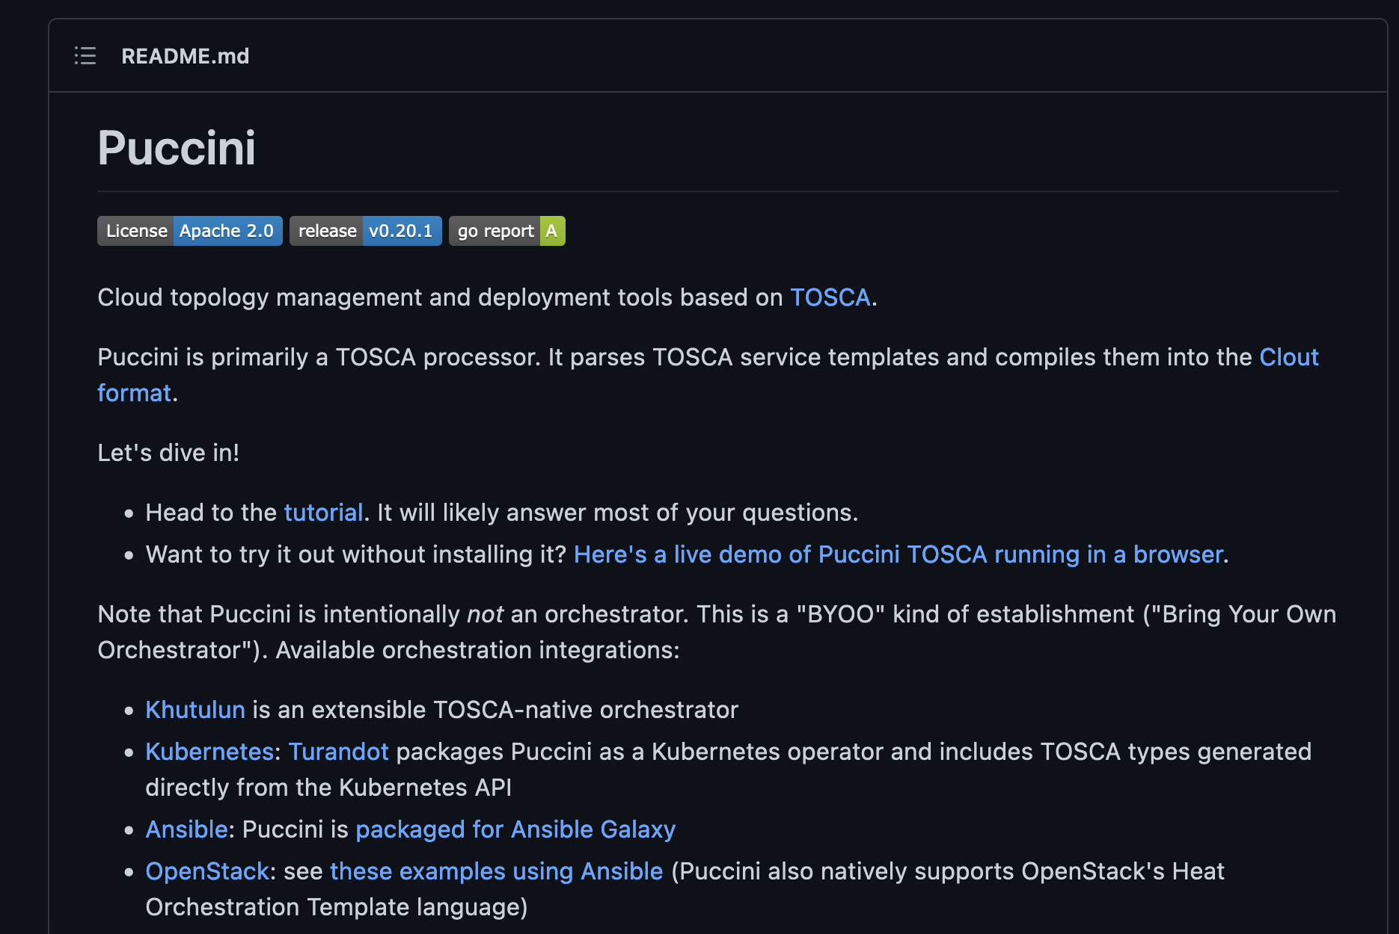



Slide 73
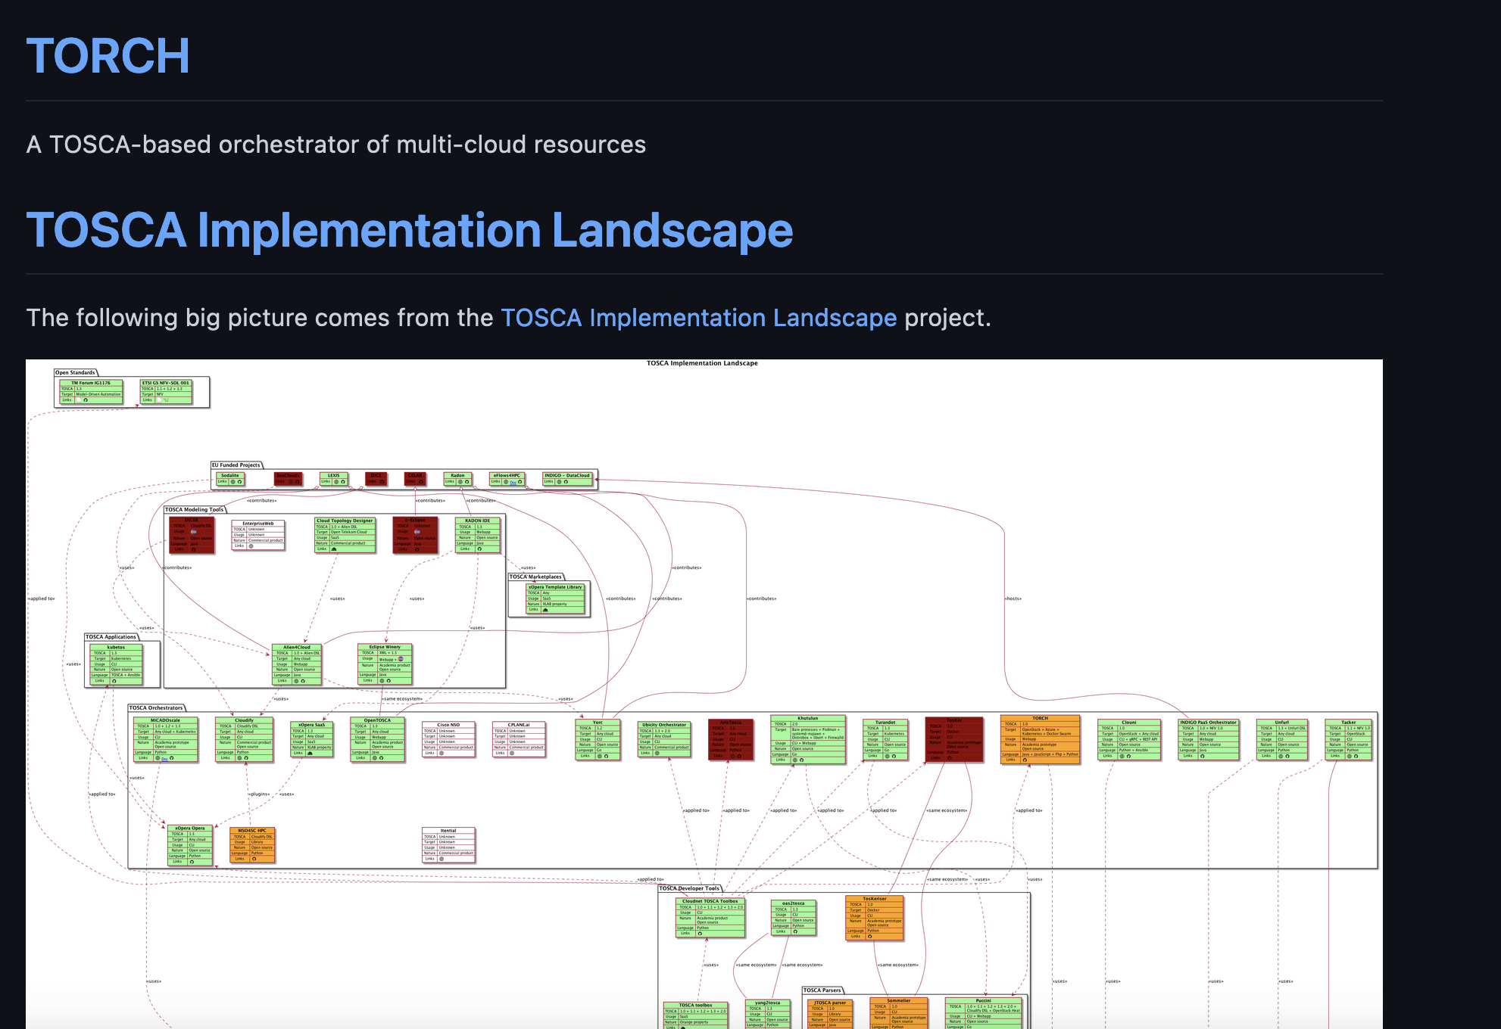
Notes:
https://github.com/oasis-open/tosca-community-contributions/wiki/Known-TOSCA-Implementations

Slide 74
What else can you do with it?
https://github.com/oasis-open/tosca-community-contributions/wiki/Known-TOSCA-Implementations
https://www.oasis-open.org/committees/tc_home.php?wg_abbrev=tosca

Slide 75
Some Other Tools
List of Related Techs (Open-Source) Already going towards TOSCA:
  CAMF: focuses on three distinct management operations: application description, application deployment and application monitoring; more info here: https://projects.eclipse.org/proposals/cloud-application-management-framework;
  CELAR: and the related tool-support within Eclipse, i.e., c-Eclipse. The CELAR project (https://github.com/CELAR/c-Eclipse) is an initiative specific for multi-cloud elasticity provisioning.
Notes:
Isomorphic, i.e., the structure and constructs are identical up to this point

Slide 76
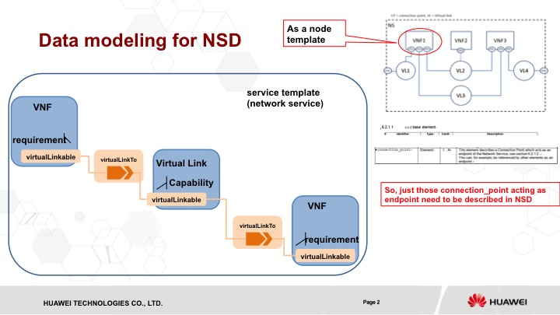
How About Network Function Virtualization?

Slide 77
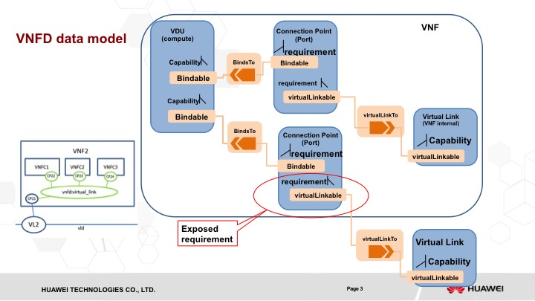

Slide 78
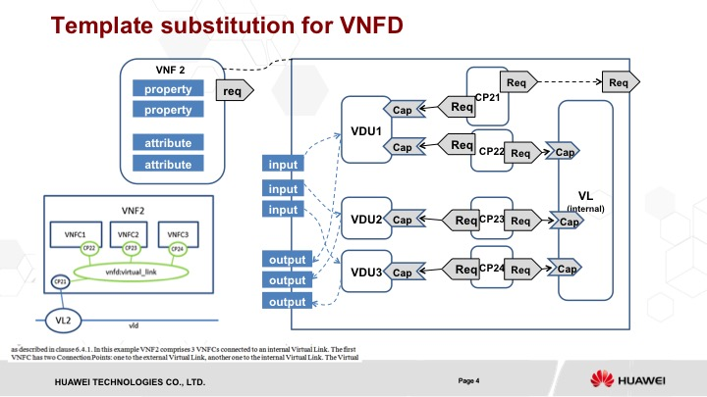

Slide 80
Example of NSD
tosca_definitions _version: # Required TOSCA Definitions version string
tosca_default_namespace : # Optional. default namespace (schema, types version)
template_name: # Optional name of this service template
template_author: # Optional author of this service template
template_version: # Optional version of this service template
description: example for a NSD.
Service_properties:
ID: # ID of this Network Service Descriptor
vendor: # Provider or vendor of the Network Service
version: # Version of the Network Service Descriptor
imports:
- tosca_base_type_definition.yaml
# list of import statements for importing other definitions files
topology_template:
inputs:
flavor ID:
node_template:
VNF1:
type: tosca.nodes.nfv.vnf
properties:
Scaling_methodology:
Flavour_ID:
Threshold:
Auto-scale policy value:
Constraints:
NS instance identification:
requirements:
virtuallink: VL1
virtuallink: VL2
virtuallink: VL3
VNF2:
type: tosca.nodes.nfv.vnf
properties:
Scaling_methodology:
Flavour_ID:
Threshold:
Auto-scale policy value:
Constraints:
NS instance identification:
requirements:
virtuallink: VL2
VNF3:
type: tosca.nodes.nfv.vnf
properties:
# omitted here for brivity
requirements:
virtuallink: VL2
virtuallink: VL3
virtuallink: VL4
CP01 #endpoints of NS
type: tosca.nodes.network.Port
properties:
type: # virtual port, virtual NIC address
requirements:
virtualLink: VL1
CP02 #endpoints of NS
type: tosca.nodes.network.Port
properties:
type:
requirements:
virtualLink: VL4
VL1
type: tosca.nodes.nfv.virtulLink
properties:
connectivity_type: E-line
connection: [CP01, CP11]
number_of_endponits: 2
VL2
type: tosca.nodes.nfv.virtulLink
properties:
connectivity_type: E-LAN
connection: [CP13, CP21, CP31]
number_of_endponits: 5
VL3
type: tosca.nodes.nfv.virtulLink
properties:
connectivity_type: E-line
connection: [CP12, CP32]
number_of_endponits: 2
VL4
type: tosca.nodes.nfv.virtulLink
properties:
connectivity_type: E-line
connection: [CP33, CP02]
number_of_endponits: 2
VNFFG:

Slide 81
Example of VNFD
tosca_definitions _version: # Required TOSCA Definitions version string
tosca_default_namespace : # Optional. default namespace (schema, types version)
template_name: # Optional name of this service template
template_author: # Optional author of this service template
template_version: # Optional version of this service template
description: example for VNF2
Service_properties:
ID: # ID of this VNF Descriptor
vendor: # Provider or vendor of the VNF
version: # Version of the VNF Descriptor
imports:
- tosca_base_type_definition.yaml
# list of import statements for importing other definitions files
topology_template:
inputs:
subsititution_mappings:
node_type: tosca.nodes.nfv.vnf2
requirements:
virtuallink: [CP21, virtuallink]
node_templates:
VDU1:
type: tosca.nodes.nfv.VDU
properties:
# omitted here for brivity
requirements:
- host:
target_filter:
properties:
- num_cpus: { in_range: [ 1, 4 ] }
- mem_size: { greater_or_equal: 2 GB }
capabilities:
# Additional contraints for the Compute node (OpSys Capability)
- os:
properties:
- architecture: { equal: x86_64 }
- type: linux
- distribution: ubuntu
Interfaces:
Standard:
create:
artifacts:
VM_image:

Slide 82
Example of VNFD
VDU2:
type: tosca.nodes.nfv.VDU
properties:
# omitted here for brivity
VDU3:
type: tosca.nodes.nfv.VDU
properties:
# omitted here for brivity
CP21 #endpoints of VNF2
type: tosca.nodes.network.Port
properties:
type:
requirements:
binding: VDU1
CP22
type: tosca.nodes.network.Port
properties:
type:
requirements:
binding: VDU1
virtualLink: internal_VL
CP23
type: tosca.nodes.network.Port
properties:
type:
requirements:
binding: VDU2
virtualLink: internal_VL
CP24
type: tosca.nodes.network.Port
properties:
type:
requirements:
binding: VDU3
virtualLink: internal_VL
internal_VL
type: tosca.nodes.nfv.virtulLink
properties:
connectivity_type: E-LAN
connection: [CP22, CP23, CP24, CP21]
number_of_endponits: 5

Slide 83
Current Status and Limitations
Deliberate moment of suspense…
Notes:
Isomorphic, i.e., the structure and constructs are identical up to this point

Slide 84
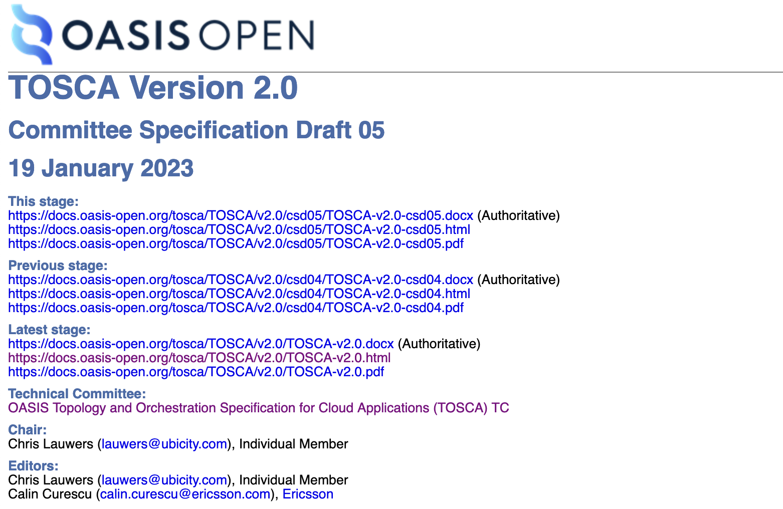


Slide 85

The LLM Bit…

